Slide 1
Introduction to Software Engineering
Muhammad kashif
CSSE3113

Slide 2
What Do We Mean by a Process?
Is a series of steps involving activities, constraints, and resources to produce an intended output
  Prepare for exams
  Conduct a software competition
  Organize a trip
  Write a term project report
Involves a set of tools and techniques
  Block diagrams
  Notations

Slide 3
How is a Process Useful?
Impose consistency and structure on a set of activities
Guide us to understand, control, examine, and improve the activities
Enable us to capture our experiences and pass them along

Slide 4
Characteristics of a Process
Prescribes all major process activities
Uses resources, subject to set of constraints (such as schedule)
Produces intermediate and final products
May be composed of sub-processes with hierarchy or links
Each process activity has entry and exit criteria
Activities are organized in sequence, so timing is clear
Each process guiding principles, including goals of each activity
Constraints may apply to an activity, resource or product

Slide 5
Characteristics of a Process
Prescribes all major process activities
Uses resources, subject to set of constraints (such as schedule)
Produces intermediate and final products
May be composed of sub-processes with hierarchy or links
Each process activity has entry and exit criteria
Activities are organized in sequence, so timing is clear
Each process guiding principles, including goals of each activity
Constraints may apply to an activity, resource or product

Slide 6
Software Lifecycle
When a process involves building a software (product), the process may be referred to as software (product) lifecycle
  Requirements analysis and definition
  System (architecture) design
  Program (detailed/procedural) design
  Writing programs (coding/implementation)
  Testing: unit, integration, system
  System delivery (deployment)
  Maintenance

Slide 7
What is a Process Model?
Description of a process, evolved overtime, in a certain format
  May use text, pictures, or a combination
  Contains key process features

Slide 8
Why is a Process Model Needed?
To form a common understanding
To find inconsistencies, redundancies, omissions
To find and evaluate appropriate activities for reaching process goals
To tailor a general process for a particular situation in which it will be used

Slide 9
What is a Software Process Model?
Models that prescribe how should development of software progress
Models that describe how is software developed in actuality

Slide 10
Software Development Process Models
Waterfall model
V model
Prototyping model
Operational specification
Transformational model
Phased development: increments and iteration
Spiral model
Unified process
Agile methods

Slide 11
Waterfall Model
One of the first process development models proposed
Works for well understood problems with minimal or no changes in the requirements
Simple and easy to explain to customers
It presents
  a very high-level view of the development process
  sequence of process activities
Each major phase is marked by milestones and deliverables (artefacts)

Slide 12
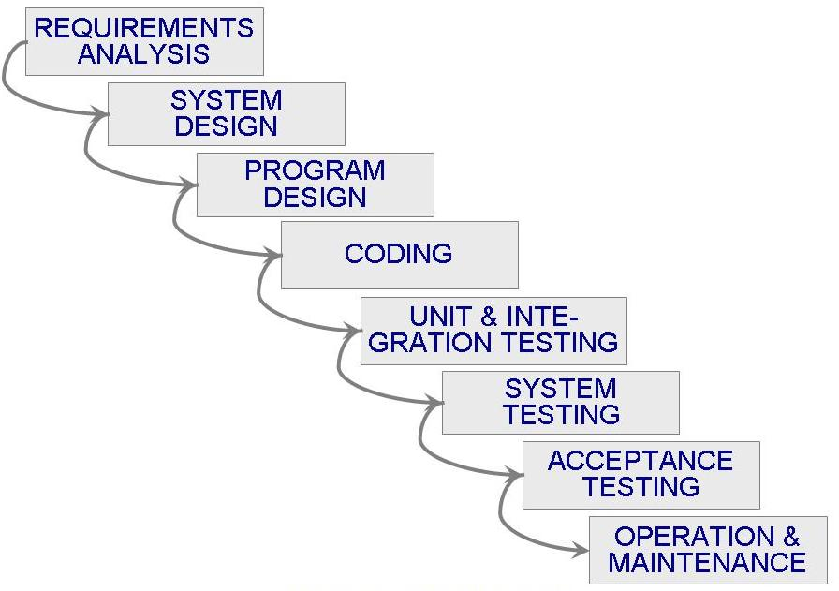
Waterfall Model (Contd.)

Slide 13
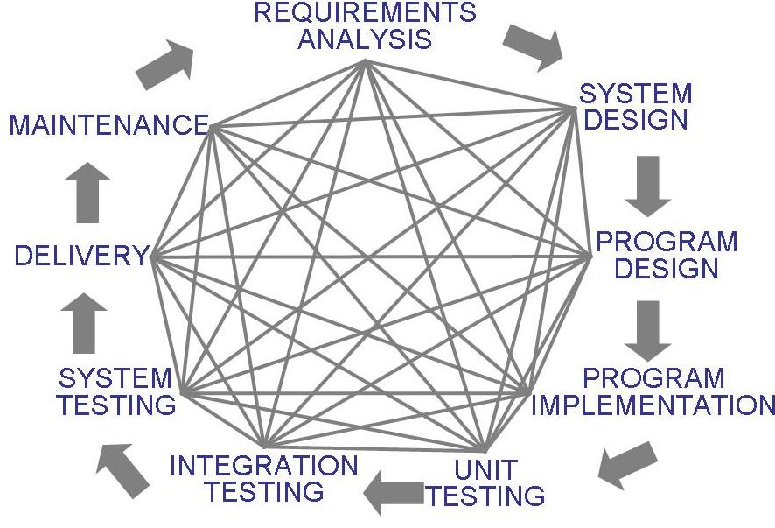
Waterfall Model (Contd.)
Uncontrolled Software Development Process
No Iterations in WF

Slide 14
Waterfall Model (Contd.)
Provides no guidance how to handle changes to products and activities during development (assumes requirements can be frozen)
Views software development as manufacturing process rather than as creative process
There is no iterative activities that lead to creating a final product
Long wait before a final product
Generates lots of documentation
Suitable for large projects

Slide 15
Waterfall Model with Prototyping
A prototype is a partially developed product
Prototyping helps
  developers assess alternative design strategies (design prototype)
  users understand what the system will be like (user interface prototype)

Slide 16
What is a Good Software Product?
Traceability
Completeness
Consistency
Correctness
Accuracy
Reliability
Error Tolerance
Execution Efficiency
McCall’s Quality Model
Efficiency
Storage Efficiency
Access Control
Integrity
Access Audit
Usability
Operability
Training
Maintainability
Communicativeness
Simplicity
Testability
Conciseness
Flexibility
Instrumentation
Self-descriptiveness
Portability
Expandability
Generality
Reusability
Modularity
Interoperability
Software System Independence
Machine Independence
Communications Commonality
Data Commonality

Slide 17
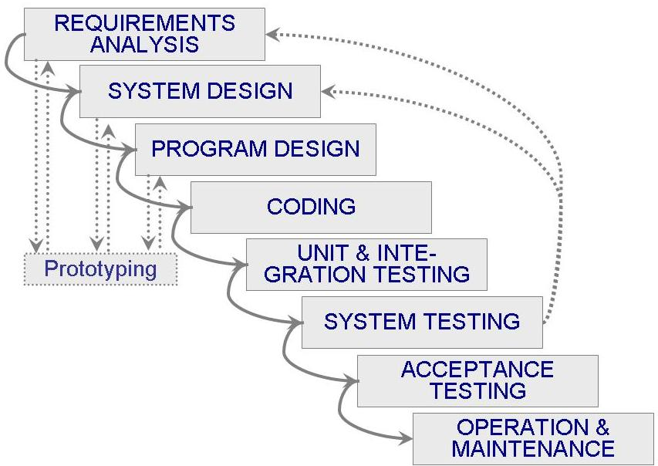
Waterfall Model with Prototyping

Slide 18
V Model
A variant of the waterfall model
Uses unit and integration testing to verify procedural design
Uses system testing to verify architectural (system) design
Uses acceptance testing to validate the requirements
If problems are found during verification and validation, the left side of the V can be re-executed before testing on the right side is re-enacted

Slide 19
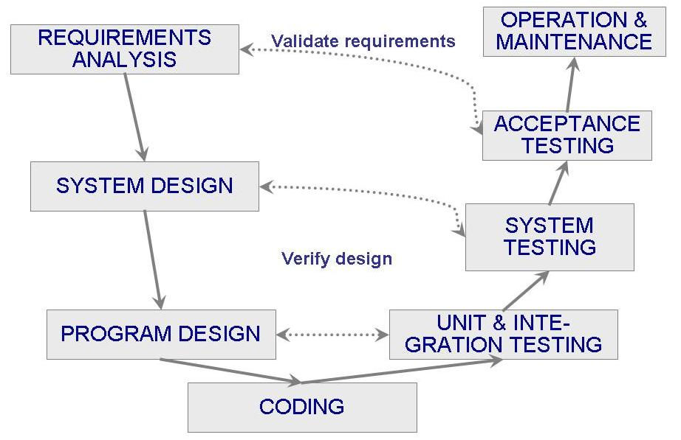
V Model (Contd.)

Slide 20
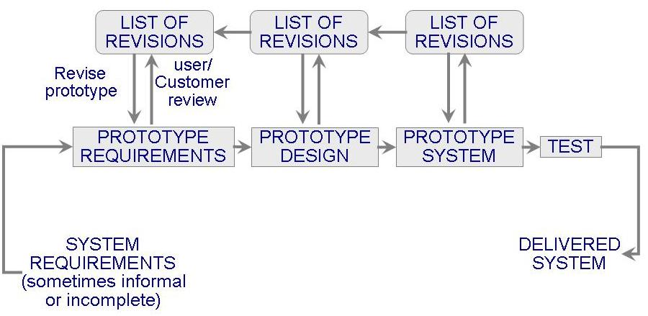
Prototyping Model
Allows repeated investigation of the requirements or design
Reduces risk and uncertainty in the development

Slide 21
Prototyping Model (Contd.)
Types:
  Evolutionary
  Throwaway
Features
  User involvement?
  Smaller projects?

Slide 22
Phased Development
Cycle time
  Time between when requirements document was written and when the system was delivered
Shorter cycle time
Decomposed system
  System delivered in pieces
    enables customers to have some functionality while the rest is being developed
Two systems functioning in parallel
  the production system (release n): currently being used
  the development system (release n+1): the next version

Slide 23
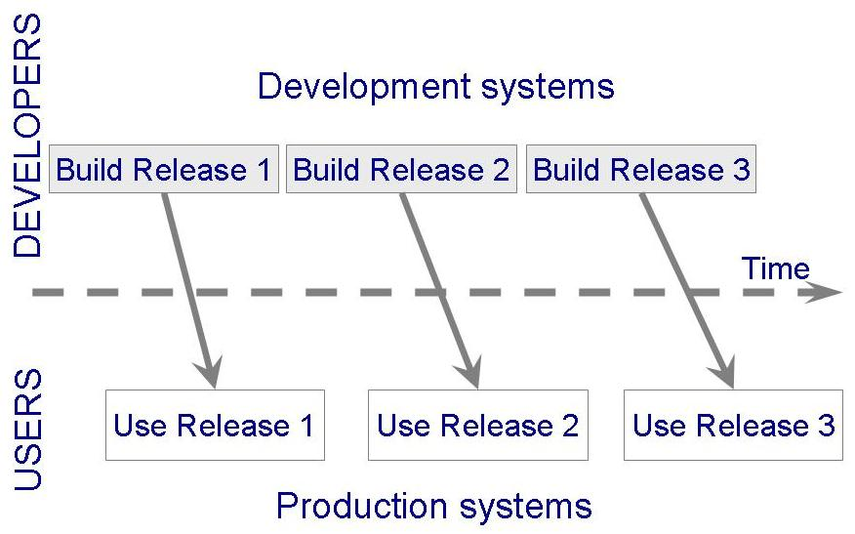
Phased Development (Contd.)

Slide 24
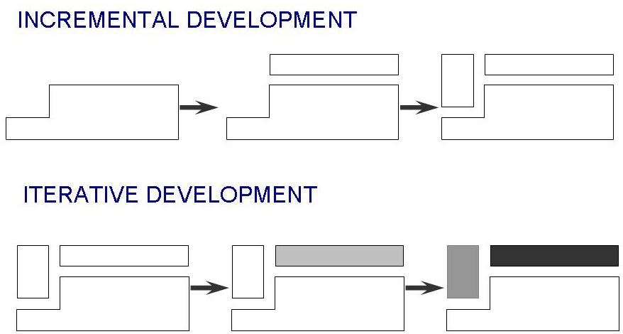
Phased Development (Contd.)
Incremental development: starts with small functional subsystem and adds functionality with each new release
Iterative development: starts with full system, then changes functionality of each subsystem with each new release

Slide 25
Phased Development (Contd.)
Training on early release
Responsive developers
Markets for early functionality
Quick and Global fixing on unanticipated problems
Ability to work on different areas of expertise with different releases

Slide 26
Lecture 5

Slide 27
Spiral Model
Suggested by Boehm (1988)
Combines development activities with risk management to minimize and control risks
The model is presented as a spiral in which each iteration is represented by a circuit around four major activities
  Plan
  Determine goals, alternatives and constraints
  Evaluate alternatives and risks
  Develop and test

Slide 28
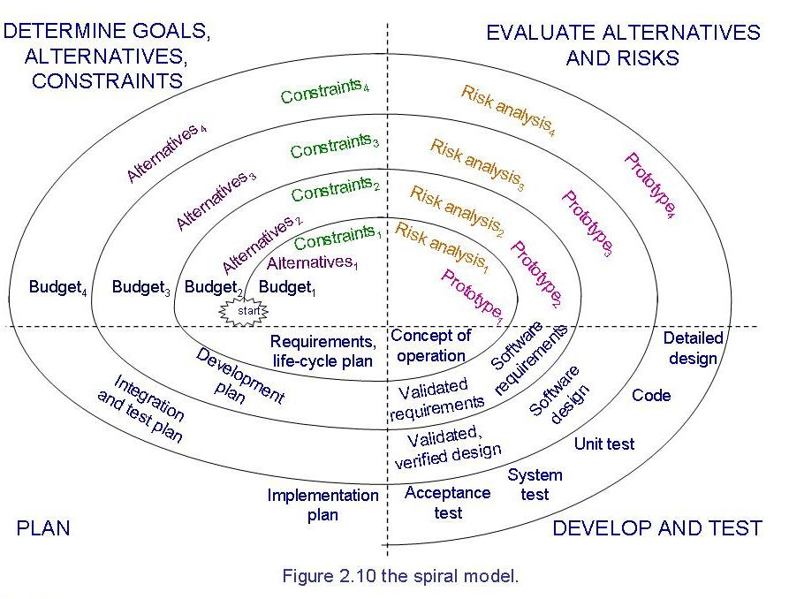
Spiral Model (Contd.)

Slide 29
Unified Process Model
Object-oriented system development methodology (system development process)
Offered by Rational/IBM, UP developed by Booch, Rumbaugh, and Jacobson
UP should be tailored to organizational and project needs
Highly iterative life cycle
Project will be use-case driven and modeled using UML

Slide 30
Unified Process Model (Contd.)
UP life cycle:
  Includes four phases which consist of iterations
  Iterations are “mini-projects”
Four Phases:
  Inception – develop and refine system vision
  Elaboration – define requirements and design and implement core architecture
  Construction – continue design and implementation of routine, less risky parts
  Transition – move the system into operational mode

Slide 31
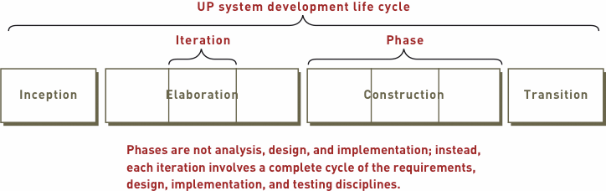
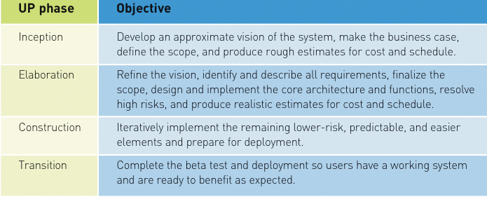
Unified Process Model (Contd.)
Images’ Source: Systems Analysis and Design in a Changing World, 4th Edition

Slide 32
Unified Process Model (Contd.)
Related development activities are called disciplines
  UP disciplines:
Business modeling, requirements, design, implementation, testing, deployment, project management, configuration and change management, and environment
Each iteration includes activities from all disciplines
Activities in each discipline produce artefacts – models, documents, source code, and executables

Slide 33
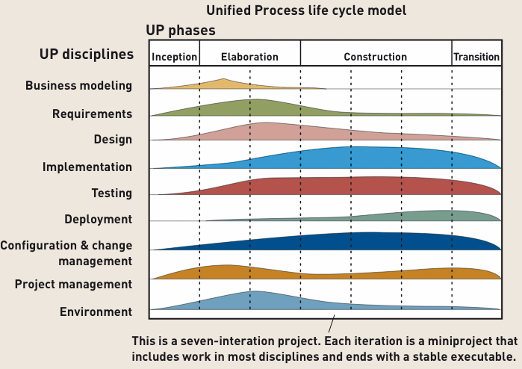
Unified Process Model (Contd.)
Image Source: Systems Analysis and Design in a Changing World, 4th Edition

Slide 34
Agile Methods
Emphasis on flexibility in producing software quickly and capably in rapidly changing environment
Agile manifesto
  Concentrate on responding to change rather than on creating a plan and then following it (chaordic)
  Value individuals and interactions over process and tools
  Prefer to invest time in producing working software rather than in producing comprehensive documentation
  Focus on customer collaboration rather than contract negotiation

Slide 35
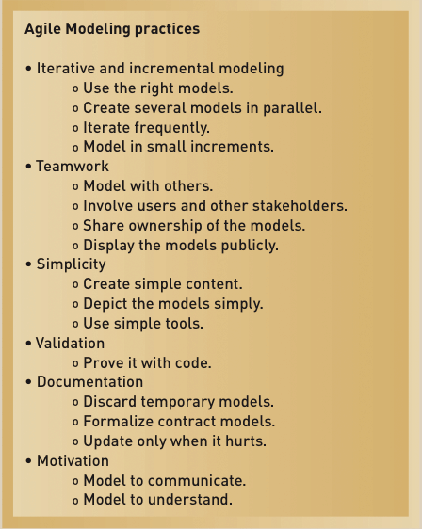
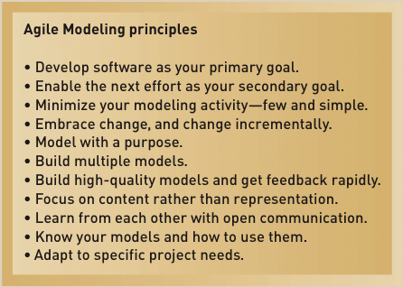
Agile Methods

Slide 36
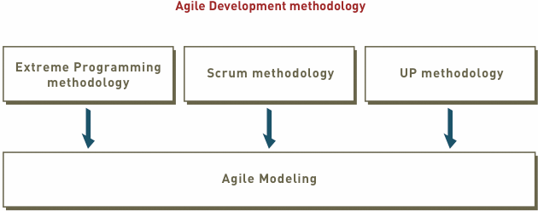
Agile Methods (Contd.)

Slide 37
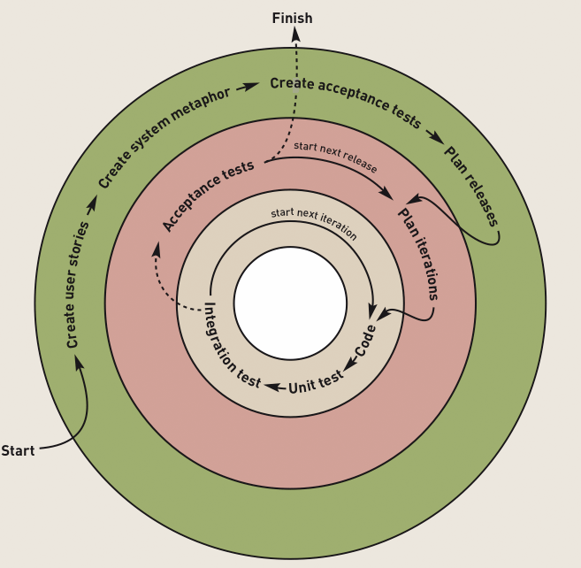
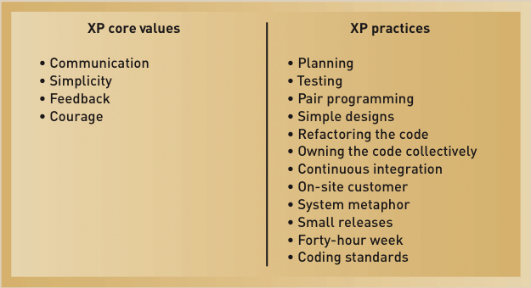
Agile Methods (Contd.)
Extreme Programming (XP)
XP Development Approach

Slide 38
Agile Methods (Contd.)
Scrum:
  A quick, adaptive, and self-organizing development methodology
  Responds to a current situation as rapidly and positively as possible

Slide 39
Agile Methods (Contd.)
Scrum Philosophy
  Responsive to a highly changing, dynamic environment
  Focuses primarily on the team level
    Team exerts total control over its own organization and work processes
  Uses a product backlog as the basic control mechanism
    The product backlog includes user functions (such as use cases), features (such as security), and technology (such as platforms).

Slide 40
Agile Methods (Contd.)
The product backlog list is continually being prioritized, and only a few of the high-priority items are worked on at a time, according to the current needs of the project and its sponsor.

Slide 41
Agile Methods (Contd.)
Scrum Organization
  Product owner
    The client stakeholder for whom a system is being built
    Maintains the product backlog list
  Scrum master
    Person in charge of a Scrum project
  Scrum team or teams
    Small group of developers
    Set their own goals and distribute work among themselves

Slide 42
Agile Methods (Contd.)
Scrum Practices
  Sprint
    The basic work process in Scrum
    A time-controlled mini-project
    Firm 30-day time box with a specific goal or deliverable
Parts of a sprint
  Begins with a one-day planning session
  A short daily Scrum meeting to report progress
  Ends with a final half-day review

Slide 43
Special THANK FOR THE MATERIALS
Mr. Haroon Abdul Waheed
Prof. Zeeshan Ali Rana
Pfleeger’s Book slides from UCF
Software Fundamentals

